Slide 1






SALES
REPORT
06 July, 2024

Slide 2
Welcome to Amazon Sales Report Presentation. Today, we delve into a comprehensive overview of Amazon sales performance, exploring the highs, challenges, and strategic insights that have shaped our journey. This presentation is more than just numbers, it's a narrative of our collective efforts, showcasing the impact of our sales strategies and the pathways to future success.
Introduction
PROJECT

Slide 3
Project Overview
01
06
Introduction
Product Performance
02
07
Data Set Columns
Home Page (Dashboard)
03
08
KPI’s
Sale Analysis (Dashboard)
04
09
Sales and Profits Demography
Conclusion
05
sales, Profit, Units by channels

Slide 4



Company Introduction
Amazon, founded by Jeff Bezos in 1994, is a global e-commerce leader known for its vast product range, innovative technology, and customer-centric approach. Starting as an online bookstore, it has expanded into numerous categories, including electronics, apparel, and groceries, while also offering digital content. With a robust marketplace model, efficient fulfillment centers, and the popular Prime membership program, Amazon delivers a seamless shopping experience worldwide. Its continuous innovation and acquisitions, such as Whole Foods and Ring, further bolster its market dominance. However, the company also faces scrutiny over labor practices and regulatory challenges.
Founder : Jeff Bezos

Slide 5




Data Set Columns
Sales Channel
Country
Delivery days
Region
Units Sold
Units Cost
Order Priority
Order ID
Profits Per Unit
Product Type
Order date
Ship date

Slide 6





Total Units Sold
Key Performace Indicaters
Amazon sold Total 513k units to 76 countries in 7 continents
Total Cost
The overall cost to manufacture or make the products were INR 93.18 millions.
Total Profits
Amazon has generated the INR 44.17 millions profits. The most Profits generated Products are Cosmetics, House hold and followed by Office supplies
sales channel ratio
the sales channel usability is in the ratio of 6:4 for channels online and offline

Slide 7
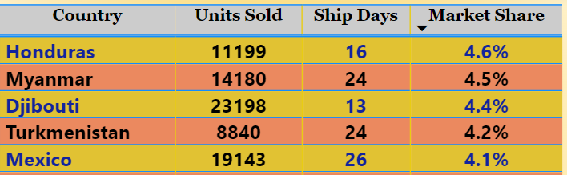
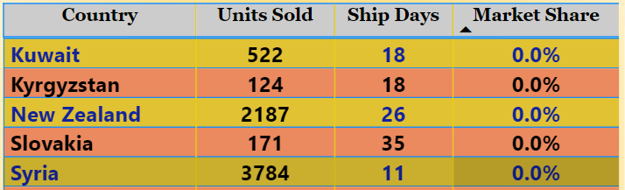
Sales and Profits Of Contries
below are the Top Market Share Countries.
while making analysis for Product sales of Amazon. we have a first insight for country wise units sold, average shipping days taken to deliver the products as well as their market share for whole sales.
Honduras holding 4.6% market share with purchasing 11,199 units and followed by Myanmar holding 4.5% market share, purchasing 14180 units. Delivery days 16 & 24 taken.
Kuwait is the least market share country with purchasing 522 units and followed by Kyrgyzstan with purchasing 124 units with average 18 days to deliver the product
Market Penetration
Above are the least Market Share Countries.

Slide 8
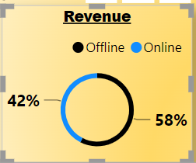
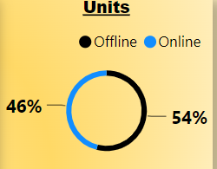
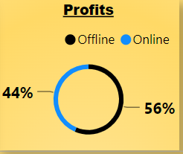
Sales channel Comparison
Total Sales
the sales channels are contributing each other towards to make products sales for 42% and 58% from OFFLINE and ONLINE.
Total Units
Sales channels are helping to make units sold at 54% and 46% from OFFLINE and ONLINE.
Total profits
With the help of sales channel amazon generating profits of 56% and 44% from OFFLINE and ONLINE

Slide 9
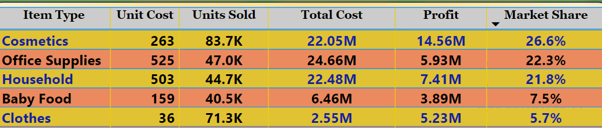

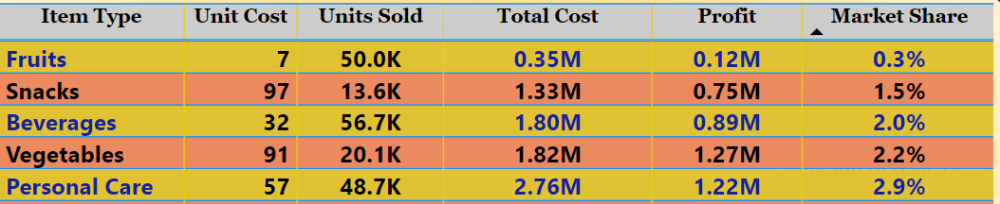
Product Performance
TOP 5 PRODUCTS BY MARKET SHARE %
Bottom 5 PRODUCTS BY MARKET SHARE %

Slide 10
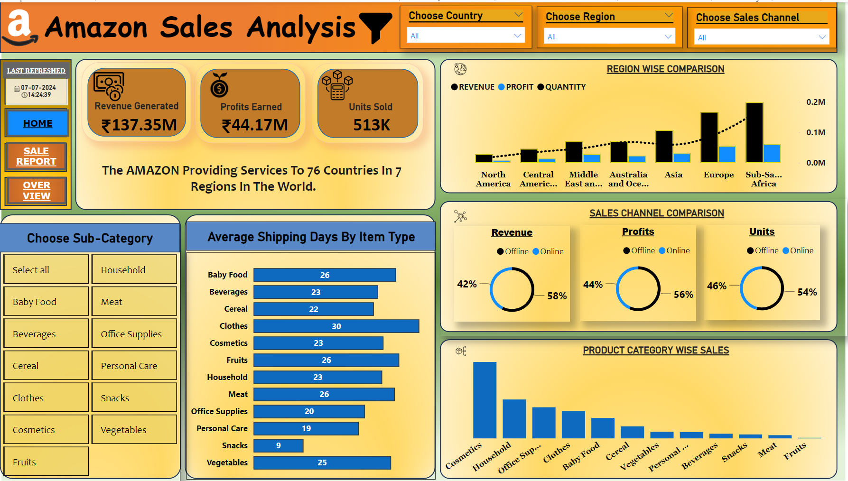
AMAZON SALES DASHBORAD

Slide 11
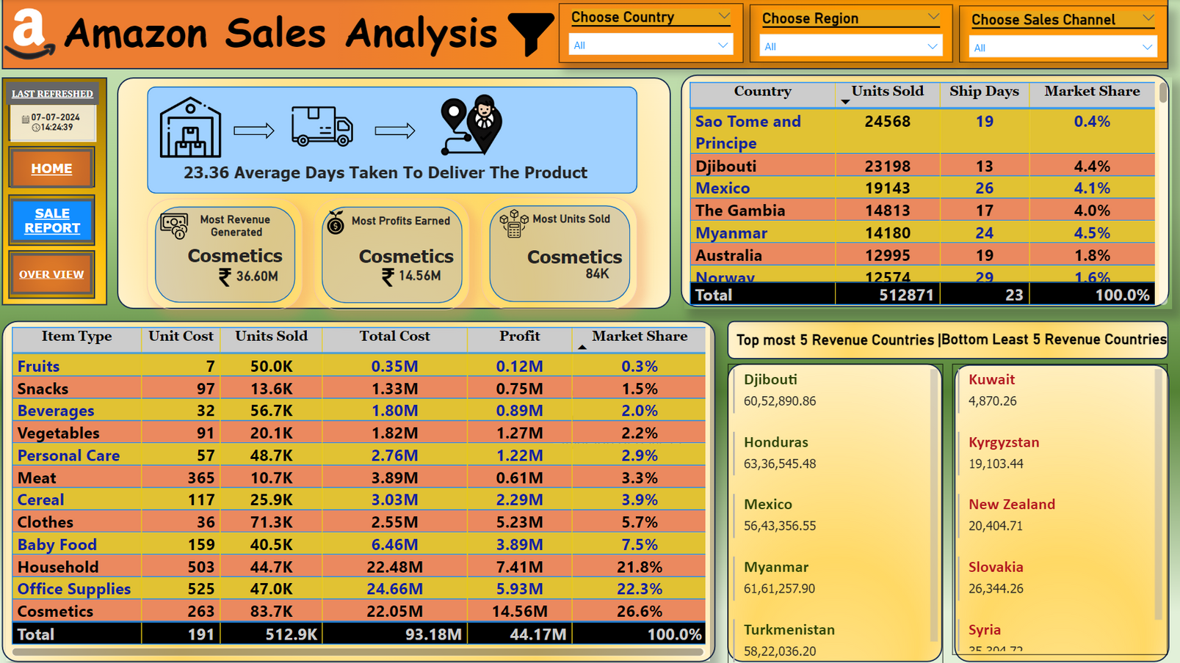
AMAZON SALES DASHBORAD

Slide 12
THANK YOU
THANK YOU
A Project BY
Srikanth Pasupula

